Slide 1
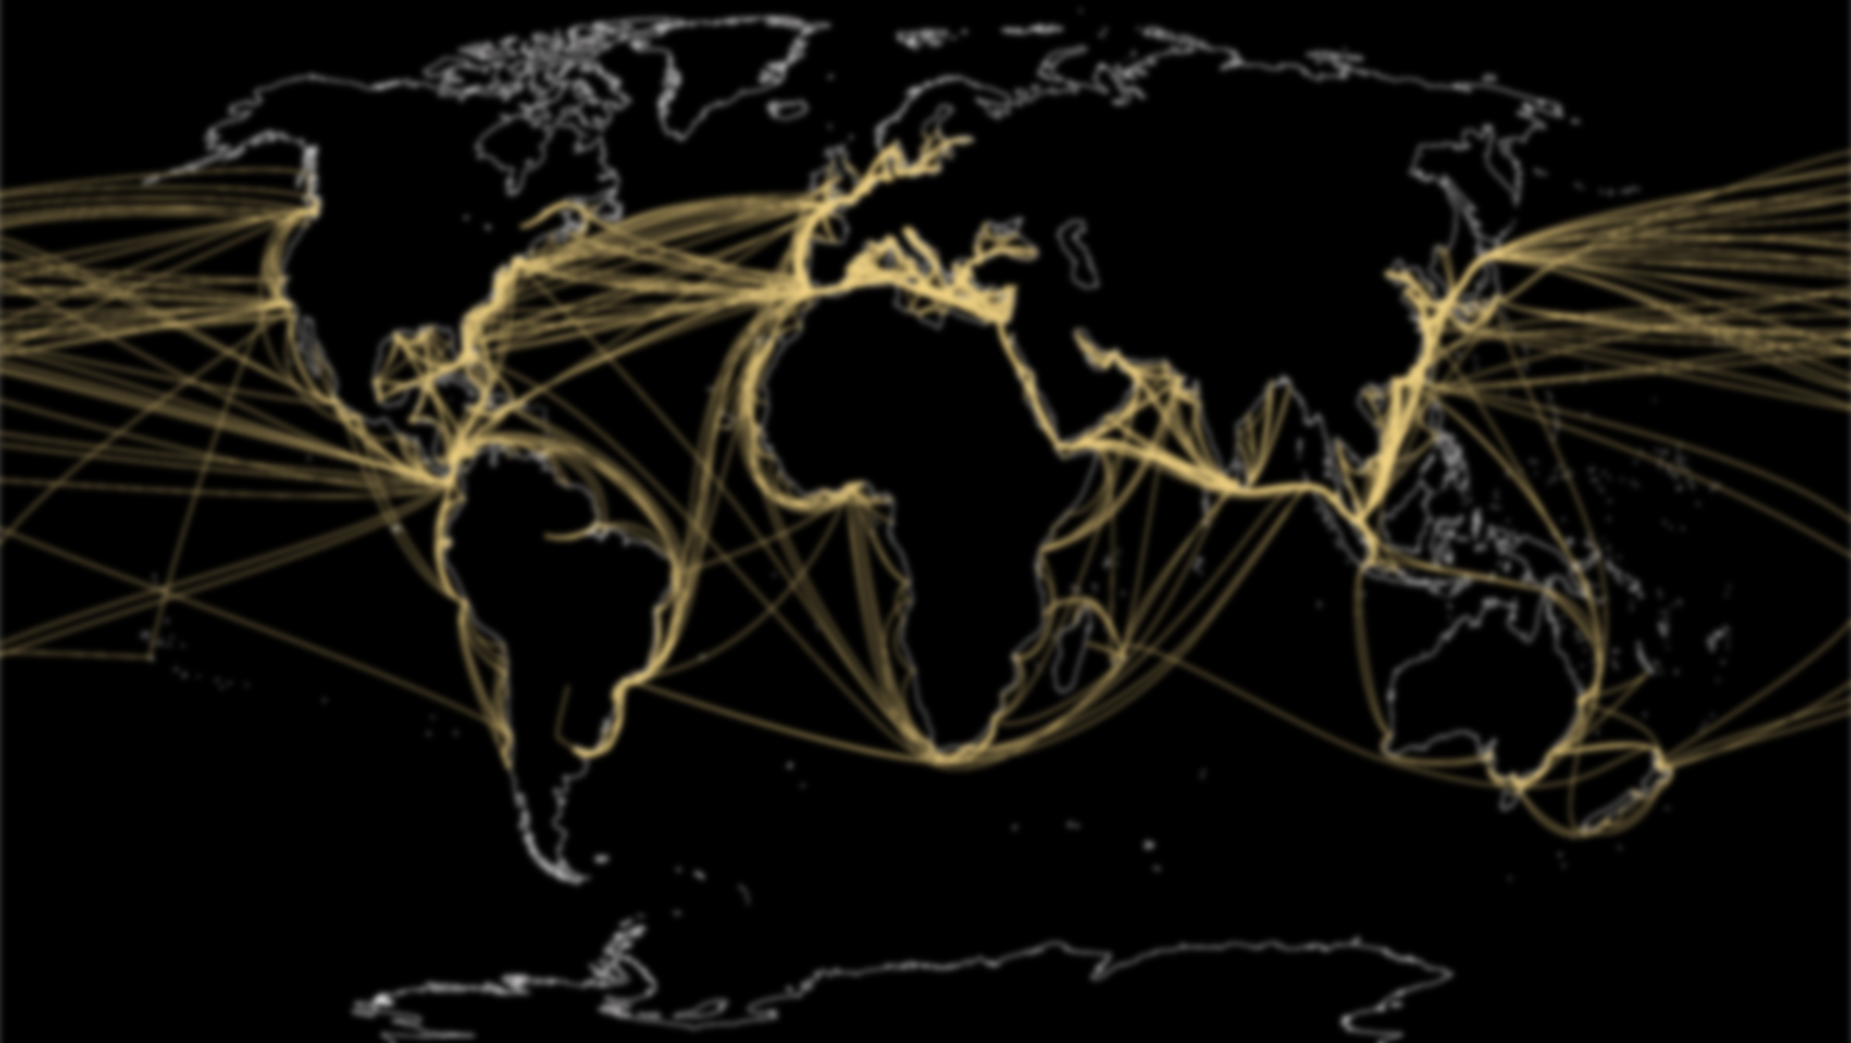

Agile and Lean organizations
Progress not perfection, the only way to build the right product
2022

Slide 2

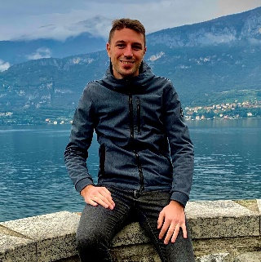
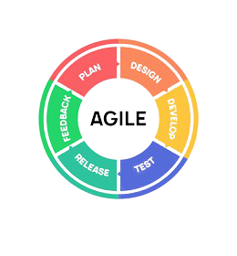
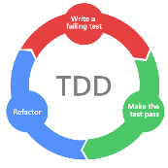



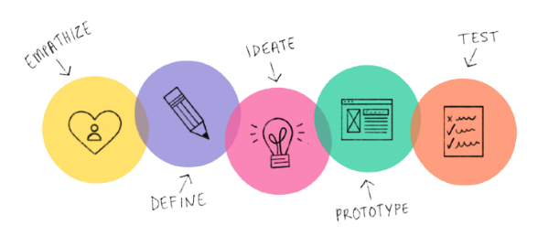
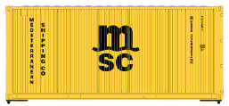












Luca Legora
Luca Legora
Agile Coach @ MSC Technology Italia
Agile Coach
MSC Mediterranean Shipping Company
Dec 2021 – Present
Product Owner
Deltatre
Feb 2020 – Nov 2021
Scrum Master
Apr 2018 – Jan 2020
Full-Stack Developer
Apr 2016 – Mar 2018
.NET Developer
Consoft Sistemi
Mar 2014 – Apr 2016
Bachelor of Computer Science – Computer Engineering
Politecnico di Torino
Oct 2013

Slide 3

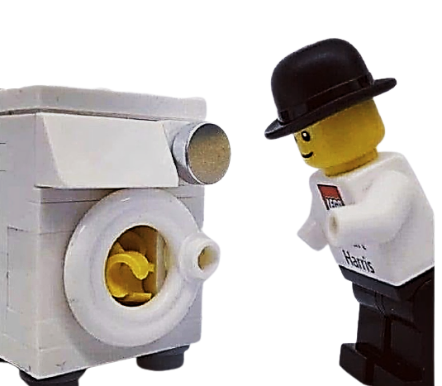
And now, draw a hand
© Copyright MSC Mediterranean Shipping Company SA

Slide 4
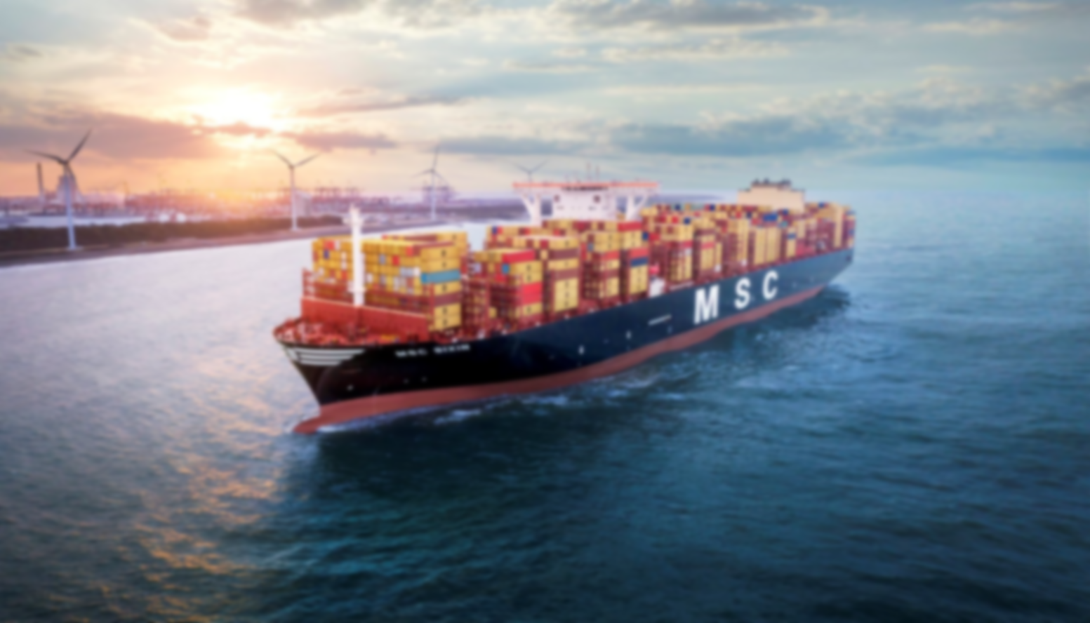
AGILE
© Copyright MSC Mediterranean Shipping Company SA
Notes:
Agile Methodologies were born way before the Agile Manifesto (from the 50s)
Feb. 2021, 17 people (devs from several companies) meet to define the Agile Manifesto

Slide 5
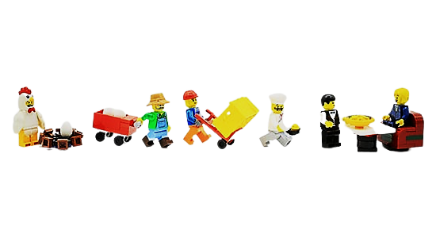
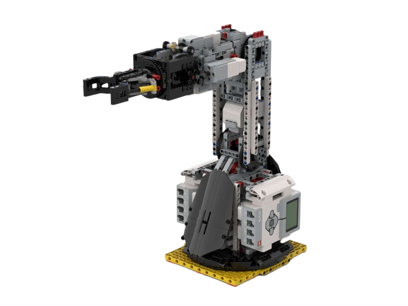

Toyota Production System
Just-in-time
Jidoka
Standardizing work
Removing inconsistency
Eliminating waste
© Copyright MSC Mediterranean Shipping Company SA

Slide 6
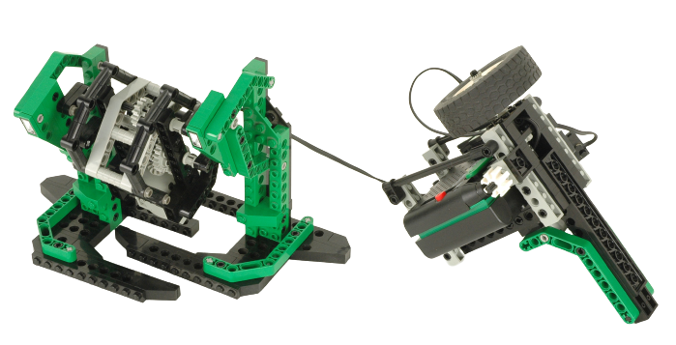
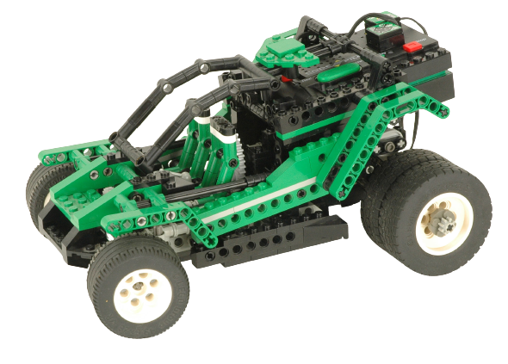
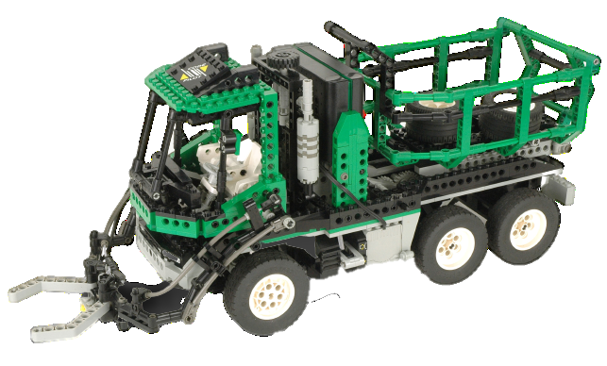
Turbulent and fast-changing environments
Rapid technological updates and increased globalization requires flexible strategic solutions that respond quickly to these rapid changes
To succeed the key is to define a plan, which is the only way to achieve and follow a vision, but always welcome changes by continuously adapting and reviewing it

Slide 7
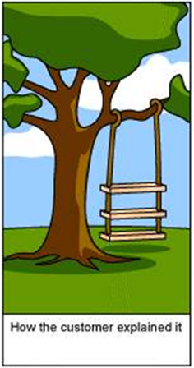



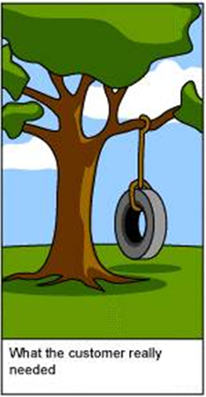
What is the Biggest Risk in developing Software Products?
Developing the wrong product!
How the customer explained it
How the Project Leader understood it
How the analyst designed it
How the Developer coded it
What the customer really needed
Notes:
Waterfall approach: you don’t know if the result is good till the end of the project

Slide 8
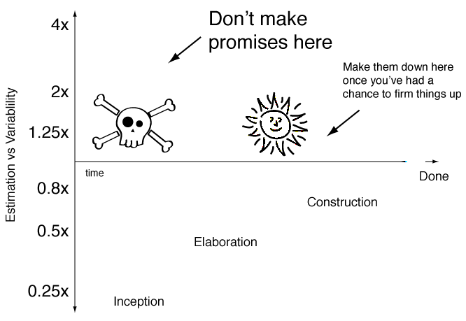
Software developments uncertainty
© Copyright MSC Mediterranean Shipping Company SA

Slide 9
Traditional vs. Agile
Traditional
Agile
ANALYSIS
ANALYSIS
DESIGN
DESIGN
DEVELOPMENT
DEVELOPMENT
TESTING
TESTING
DELIVERY
Time
DELIVERY
Time
50% Done and not ready to use
50% Done and already ready to use
Notes:
Traditional: Scope fixed, Cost and Time variables
Agile: Cost and Time fixed, Scope variable

Slide 10
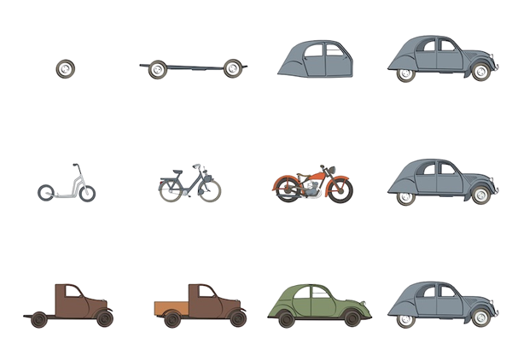

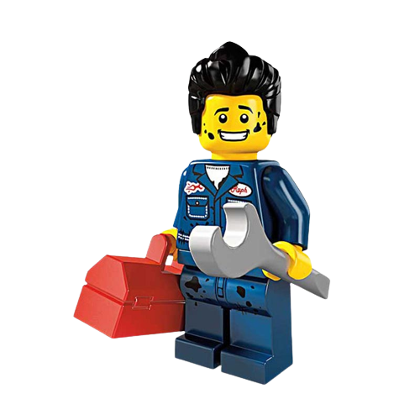

Iterative and incremental
© Copyright MSC Mediterranean Shipping Company SA

Slide 11

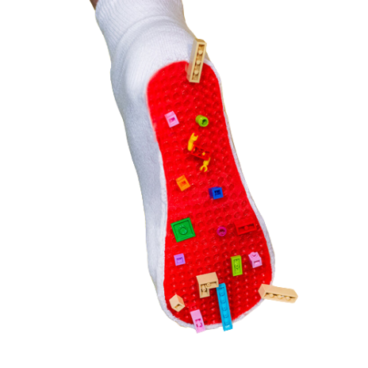

Data driven
We did research and found that about 15% of the time members were manually advancing the series within the first five minutes. This gave us confidence that a lot of people wanted to skip the intro.
The Netflix Team

Slide 12


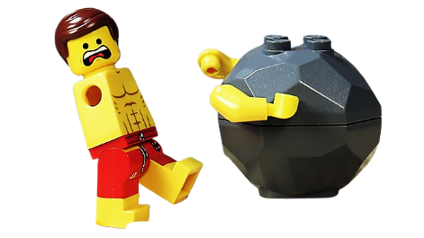
Product possible outcomes
Good
Right
Perfect

Slide 13


We are looking for talents
WE’RE HIRING Get on board!
Notes:
Microsoft Academy – Object Oriented Programming + Frontend Basics

